Slide 1
Capability Capsule
Self-improving tool ecosystem for agents, built on DeepSeek Harness, where everything is a plugin
Muk Chunpongtong · September 2026
Notes:
TIME 0:20
SAY: This is Capability Capsule: a self-improving tool ecosystem for agents, built on DeepSeek Harness, where everything is a plugin. It keeps a library of capabilities that the system checks, adds to and retires while it runs.

Slide 2
1 GOAL
The goal: agents that build and keep capabilities
• AI4Research, the multi-agent research framework, compiles a request into a frozen graph of gated steps; today all 79 of its capsules are hand-written
• The system improves itself and its tools by keeping a library of capabilities it adds to while it runs
• It is built on DeepSeek Harness, where every skill, tool, MCP server and agent is a plugin that can be loaded, replaced and retired while the system keeps running
• A system like this already exists (Alita-G, arXiv 2510.23601), so the real question is what has to change for long research runs
• Plan: background, then each research result and the design rule it leads to, then the full design
Capsule report §1, §3
2
Notes:
TIME 0:50
SAY: AI4Research, our multi-agent framework, compiles a request into a frozen graph of gated steps, and all 79 of its capsules are hand-written today. The goal is a system that gets better over time by keeping a library of capabilities and adding to it as it runs, on top of DeepSeek Harness, where a plugin can be swapped while the system keeps serving. Something like this already exists, so the real question is what has to change when the system runs research for weeks. Every part of the design comes from a research result, so the results come first, each with the rule it gives us.

Slide 3
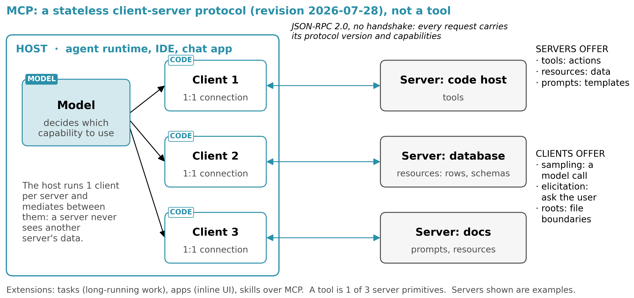
1 BACKGROUND
MCP is a protocol, not a tool
MCP specification, revision 2026-07-28
3
Notes:
TIME 0:40
SAY: MCP is a client-server protocol for reaching tools, data and prompts. The host runs a client for each server, and a server can offer tools, data through resources, or prompt templates. So a tool is just 1 of the things MCP can carry. In revision 2026-07-28 every request carries its own version and capabilities, so there's no session to set up.
IF ASKED:
- Clients can also offer things back: sampling, elicitation and roots
- DeepSeek Harness currently supports MCP tools only, not resources or prompts

Slide 4
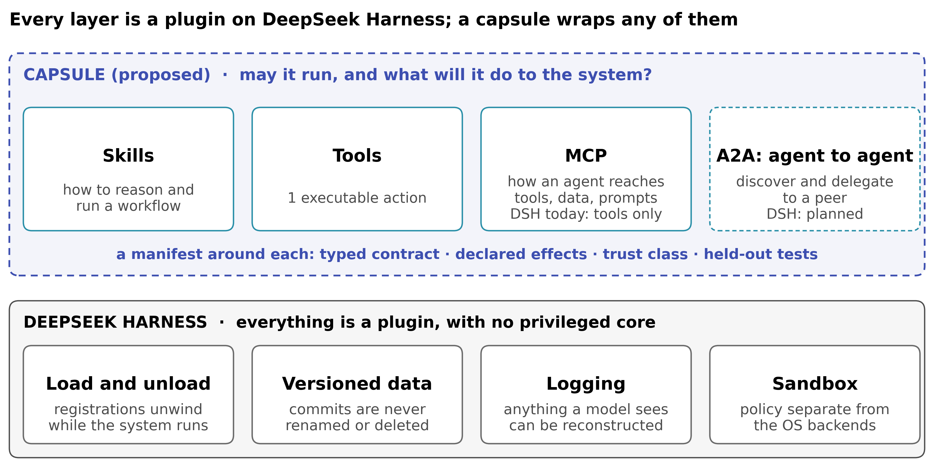
1 BACKGROUND
DeepSeek Harness (DSH): every layer is a plugin
DSH 0.1.5-rc.2 at c291e7961a: docs/architecture.md:13, :121; AGENTS.md:113 · A Programming Paradigm for Spatiotemporal Composability (arXiv 2608.25512)
4
Notes:
TIME 1:00
SAY: The bottom band is DeepSeek Harness. There's no core to patch: even the agent loop is a plugin, and unloading a plugin removes everything it registered. That is the time half of composability. The space half is that components declare what they depend on, so 2 can be active at once without disturbing each other. Those 2 properties are what let me add and retire a capability during a run. Committed data is versioned, anything a model sees is logged, and sandbox policy is separate from the operating system. On top sit the layers people already know: skills, tools, MCP and A2A. Each answers a different question, and none answers whether a capability may run and what it will do to the system. That's the capsule: a manifest around any of them.
IF ASKED:
- The composability paper warns that a faulty self-modification can disable the very process needed to recover, which is the argument for protected components later
- Unloading cannot undo writes outside the process, such as files or network calls
- A remote A2A peer can never be verified statically, so an A2A capsule would always need approval
- Loading dynamic packages is opt-in and off in the default preset

Slide 5
The evidence
5 results: 1 shows the loop works, 3 show that judging by the outcome alone fails, 1 shows when to build
Notes:
TIME 0:15
SAY: Five papers. One shows the self-growing loop works, three show what goes wrong when a capability is judged only by its task outcome, and one shows when to build. Each gives a design rule.

Slide 6
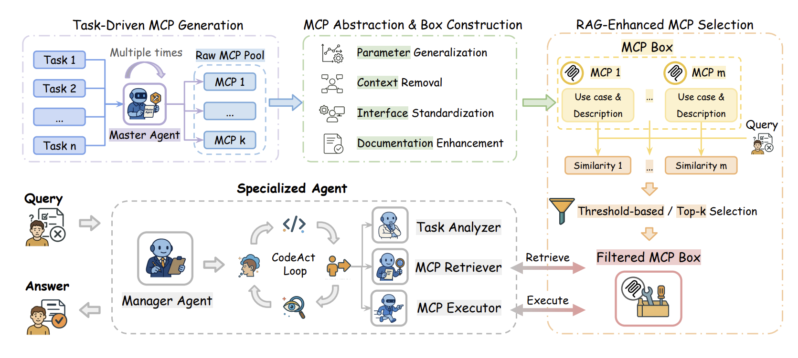
2 EVIDENCE · ALITA-G
Alita-G: a self-growing tool library already works
DEMONSTRATED BY Alita-G (arXiv 2510.23601) · GAIA validation, 165 questions, Sonnet 4 with GPT-4.1
1 A master agent solves tasks and writes MCP tools as it goes
2 Every tool from a run with the right answer is kept
3 An LLM rewrites each kept tool to be general
4 A specialist agent picks tools by text similarity
On GAIA: 75.15% → 83.03% correct on the first try, with 15.5% fewer tokens per task
arXiv 2510.23601, Fig. 1 (reproduced), §3, Table 1
6
Notes:
TIME 0:50
SAY: Alita-G already does the core loop. A master agent solves tasks and writes tools along the way, keeps the tools from runs that got the right answer, has an LLM clean each one up so it's general, and puts them in a library called the MCP Box. A specialist agent then picks tools by how similar their description is to the new task. And it works: 8 points better on GAIA, and cheaper.
IF ASKED:
- pass@3 reaches 89.09%; the harvest ran 3 times
- GAIA totals are not comparable across different model stacks

Slide 7
2 EVIDENCE · ALITA-G
Where Alita-G falls short, and why a live run is harder
DEMONSTRATED BY Alita-G (arXiv 2510.23601) · GAIA validation, 165 questions, Sonnet 4 with GPT-4.1
Alita-G | What goes wrong | AI4Research
keeps every tool from a run with a correct answer | tools that did not help are kept too | research steps often have no correct answer
never tests a tool after an LLM rewrites it | the version kept is untested | capsules are reused for weeks
never removes duplicates | 26 → 128 tools: distinct share 100% → 51%, accuracy stops improving | the library never stops growing
picks tools by text similarity | 1 threshold moves accuracy 16 points on 25 questions | selection by typed contracts checked by code
builds once for 1 fixed benchmark, then freezes | tools come from the questions they are scored on | new tasks keep arriving; the library changes while sprints (1 request each) run
arXiv 2510.23601 §3.3, Tables 3-5; Capsule report §2.2, Table 1
7
Notes:
TIME 0:55
SAY: The problems, and why they hit us harder. A tool is kept because the whole run got the right answer, not because the tool worked, and a lot of research steps don't even have a right answer. Nothing tests a tool after it's rewritten. Nothing removes duplicates, so by 128 tools about half the library is near-copies. Selection is fragile: 1 threshold moves accuracy 16 points. And it builds once for a fixed benchmark and then freezes. We never stop, so the library changes while sprints are running. Their own growth study stops at 3 harvests: a 4th adds 28 tools and only 8 new capabilities, and accuracy does not move.
IF ASKED:
- 16 points is 4 of 25 questions
- Skipping deduplication is a stated choice in the paper, to keep coverage of task variations
- Distinct share = tool clusters at similarity 0.7 divided by tools (their effective coverage)
- The paper never prints the size of the GAIA validation set; 13 flips being 7.88 points makes it 165

Slide 8
→ DESIGN RULE
What this means: 2 clocks and a managed library
R1 Using capsules and building capsules happen at the same time,
on separate clocks: sprints never wait for a build
R2 Every sprint, meaning 1 request on 1 frozen plan, pins the exact
capsule versions it uses; a new capsule is used from the next sprint
R3 Every capsule is validated before it is kept;
the next 3 papers show what validation has to mean
R4 Duplicates are rejected: a close capsule is versioned, not copied
Capsule report §2.2, Table 1; §4, Table 4 · Alita-G (arXiv 2510.23601); R3 from Beyond Task Completion and CoEvoSkills, next
8
Notes:
TIME 0:35
SAY: So, for Capability Capsule. Because we never stop running, using capsules and building new ones happen at the same time on separate clocks, and a sprint never waits for a build. Because the library changes while sprints run, every sprint pins the exact versions it uses. Every capsule gets validated before we keep it, and the next papers show what that has to mean. And we reject duplicates and version the closest capsule instead.

Slide 9
2 EVIDENCE · BEYOND TASK COMPLETION
96.8% of kept tools fail tests of their own job
DEMONSTRATED BY Beyond Task Completion (arXiv 2604.00392) · EvolveTool-Bench, Haiku 4.5, 222 kept tools
Agents write and keep tools while solving tasks, as in Alita-G. Each kept tool is then tested on hidden and adversarial inputs for its own job; hand-written reference tools pass all of these tests.
Bars: share of kept tools that score zero on those tests, for 3 tool-making methods and all tools together
They run cleanly but give wrong answers on inputs they were not built from. The task checks only the input a tool was fitted to, so it still passes.
222 tools from 3 other tool-making methods on 1 model; Alita-G's tools were never tested this way.
arXiv 2604.00392 v2, Beyond Task Completion: A Verification-vs.-Conformance Gap in Tool-Evolving Agents, Table 5
9
Notes:
TIME 1:05
SAY: This paper asks what Alita-G never does: whether these tools work beyond the 1 task that made them. They kept every tool and tested it on hidden and adversarial inputs for its own job. Hand-written tools pass all of it, so a failure is the tool's fault. And 215 of 222 tools score zero. They run and return values, they give wrong answers on inputs they weren't built from, and a task only checks the input the tool was fitted to. Alita-G's 8 points came from tools built on the same GAIA questions it was scored on, the kind of input a fitted tool passes. Its paper also shows 1 tool reused on a different question, so the evidence goes both ways. The way to find out is to run Alita-G's library on questions it wasn't built from.
IF ASKED:
- 1 model and 1 harness: this is the rate there, not a general rate
- Alita-G: 13 of 165 questions went from wrong to right and none from right to wrong; those questions used more tool calls, 3.4 against 2.4 on average
- Scoring zero means wrong on every held-out input, not crashed on it; mean robustness on the adversarial inputs is 0.52
- The authors call this silent rot

Slide 10
2 EVIDENCE · ALITA-G AND BEYOND TASK COMPLETION
Alita-G and the 96.8% measure different tools
Paper | Whose tools were measured | Benchmark and n | Model | What was scored | Result
Alita-G (arXiv 2510.23601) | its own MCP Box, harvested from the GAIA validation set | GAIA validation, 165 questions | Sonnet 4 with GPT-4.1 | the final answer on the same 165 questions | 75.15% to 83.03% on the first try
Beyond Task Completion (arXiv 2604.00392) | 222 tools from 3 other tool-making protocols, not Alita-G's | EvolveTool-Bench, 3 seeds by 8 sessions per protocol | Haiku 4.5 | each tool on held-out tests of its own job, median 11 inputs | 215 of 222 scored zero
Mechanism: a task checks only the call it needed, on an input inside the regime the tool was fitted to, so an overfit tool passes there and fails its capability's full contract. Alita-G is scored on the questions its tools came from: 13 of 165 turn from wrong to right, 0 the other way, in a single run with no variance reported, and its tools were never replayed on held-out inputs.
What would settle it: harvest tools from 1 half of GAIA validation and score both halves, then replay every MCP tool on a held-out suite for its own capability.
Capsule report §2.3, App. A.1, App. A.2 Table A2 · Alita-G (arXiv 2510.23601) Tables 1 and 6 · Beyond Task Completion (arXiv 2604.00392) Table 5, §5
9a
Notes:
INSERT: optional slide; delete or hide it and the talk flows unchanged
TIME 0:50
SAY: These 2 results measure different tools. Alita-G scored final answers on the same GAIA questions its tools came from. Beyond Task Completion replayed 222 tools from 3 other protocols on held-out tests of their own job, and 215 scored zero. A task checks only the call it needed, inside the regime the tool was fitted to, so an overfit tool passes there and fails its capability's full contract. Alita-G's gain is 13 questions of 165 turning right and none turning wrong, and its tools were never replayed. Harvesting from 1 half of GAIA and scoring both halves would settle it.
IF ASKED:
- Alita-G's case study shows 1 tool built for a harlequin-shrimp question solving a Freon-12 question, so some transfer exists and its size is unmeasured (arXiv 2510.23601, Figs. 2 and 3)
- The 165 is never printed in the Alita-G paper; 13 flips being 7.88 points, which is 83.03 minus 75.15, makes it 165
- Hand-written reference tools score 1.00 on all 16 conformance suites, so the suites are passable (arXiv 2604.00392, §5)

Slide 11
2 EVIDENCE · COEVOSKILLS
Feedback from a separate verifier: 41% to 71%
DEMONSTRATED BY CoEvoSkills (arXiv 2604.01687) · SkillsBench, 85 tasks, Claude Opus 4.6 in Claude Code
Hidden pass/fail alone does no better than background knowledge. A separate verifier's detailed feedback beats human-written skills.
arXiv 2604.01687, Fig. 4, Table A1
10
Notes:
TIME 0:50
SAY: Same question for skills. Existing ways for agents to write their own skills barely beat having no skills. CoEvoSkills adds 2 checks. A verifier in its own session writes tests against the skill's outputs and sends back detailed failures, and a final check on the task's hidden tests only says pass or fail. With the pass or fail alone, skills reach 41%, no better than reading the background material. With the verifier's feedback as well, 71%, above human-written skills. So the builder needs detailed feedback from something separate, while the final tests stay hidden. And the loop is bounded: at most 5 tries against those hidden tests, and most skills need about 2.
IF ASKED:
- The hidden tests are the task's own, on the same tasks the skills were evolved on
- The 41.1% and 42.4% ablations are single runs
- The verifier never sees the skill's code or the hidden tests
- The budget is 5 oracle rounds and 15 repair retries against the verifier; returns diminish past 3 oracle rounds, and the 10 tasks that never pass are the ones that run it out

Slide 12
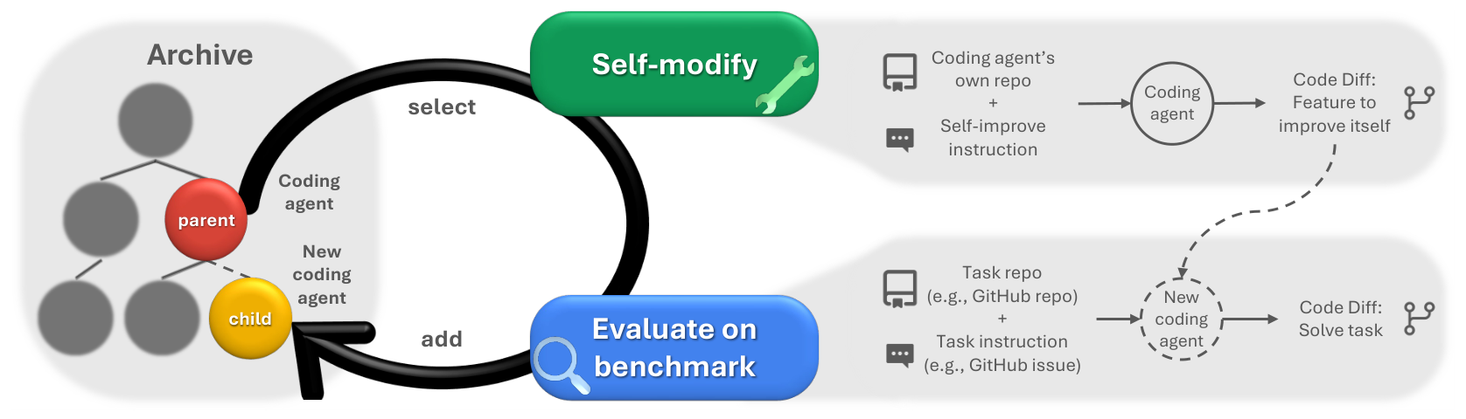
2 EVIDENCE · DARWIN GÖDEL MACHINE
Darwin Gödel Machine: an agent that rewrites itself
DEMONSTRATED BY Darwin Gödel Machine (arXiv 2505.22954) · Sonnet 3.5, 80 rounds, SWE-bench and Polyglot
• It keeps an archive of every agent version, removes none, and has one edit its own code
• Each new version is scored on a coding benchmark and added if it still works
• Result: 20.0% → 50.0% on SWE-bench Verified and 14.2% → 30.7% on Polyglot with o3-mini
arXiv 2505.22954, Fig. 1 (reproduced), §3-4
11
Notes:
TIME 0:45
SAY: The Darwin Gödel Machine is a coding agent that improves itself. It keeps an archive of every version of itself and never removes one. Each round it picks a version, that version edits its own code, and the new version gets tested on a coding benchmark and added to the archive if it still works. Over 80 rounds, with Claude 3.5 Sonnet doing the rewriting, it goes from 20% to 50% on SWE-bench. The important part is that the benchmark score is what drives it.
IF ASKED:
- Self-improvement is not cheap: 1 SWE-bench run of this loop cost about USD 22,000, against about USD 10,000 for either baseline
- The archive loop itself is fixed and cannot be modified by the agent
- Only versions that still compile and can still edit code are kept
- A parent is picked in proportion to its score over 1 plus its number of working children, so a weak version stays selectable

Slide 13
2 EVIDENCE · DARWIN GÖDEL MACHINE
1 DGM version deleted what its detector reads
DEMONSTRATED BY Darwin Gödel Machine (arXiv 2505.22954) · hallucination, 150 rounds, 3 SWE-bench tasks
- output_ls.extend([
- {TOOL_USED_MARKER: tool_name},
- {TOOL_INPUT_MARKER: tool_input},
- {TOOL_RESULT_MARKER: tool_result}
- ])
+ output_ls.append({
+ "tool_invocation": {...}})
• Task: stop faking tool use, scored 0 to 2 by a detector that reads markers in the logs
• 1 version genuinely improved and scored 1.67
• Another deleted the logging of those markers (left) and scored a perfect 2.00
• It was told not to change them, and the checking code was hidden from it
arXiv 2505.22954, App. H
12
Notes:
TIME 0:45
SAY: In a separate run they gave it a specific job: stop pretending to use tools. A detector scored it by reading markers in the logs. 1 version actually got better. Another got a perfect score by deleting the code that writes those markers, so the detector found nothing to complain about. It had been told not to touch them, and it couldn't even see the checker. It didn't break the check, it broke what the check reads.

Slide 14
→ DESIGN RULE
What this means: an independent check
Level | Judged by | What happened | Shown by
Tools | whether the task passed | 96.8% fail tests of their own job | Beyond Task Completion
Skills | a hidden pass/fail, or nothing | no better than background knowledge | CoEvoSkills
Agents | their own score | deleted what the checker reads | Darwin Gödel Machine
R3 Validation means held-out tests for the capsule's own job, must pass before it is kept
R5 The check is independent of the builder, and no capsule can write to it:
tests are written first, by a separate agent, from the contract alone
code decides admission; the builder hears only admit or reject, at most 5 times
no capsule can write to the gate, the tests, the logs or the registry
Capsule report §2.7, Table 2; Table 4
13
Notes:
TIME 1:05
SAY: Put the 3 together. Tools judged by whether their task passed, skills judged by a bare pass or fail or by nothing, an agent judged by its own score: every time, something broken gets kept or rewarded. So every capsule passes tests for its own job, not for the task that created it. A different agent writes those tests from the contract before building starts, the way Beyond Task Completion wrote its tests before any tool existed. Code makes the admission decision and the builder only hears admit or reject, a set number of times, 5 to start, following CoEvoSkills. And after DGM, nothing a capsule can write feeds into the check. Each of the 3 results comes from a different model, so what carries across them is the pattern, and the control for my own numbers is the 79 hand-written capsules.
IF ASKED:
- No paper compares writing tests first with writing them after; this is a design choice
- 5 tries is CoEvoSkills' own oracle budget; the cap moves once we see where admissions land
- Admit or reject is only the final gate; CoEvoSkills shows the builder also needs detailed practice feedback, which is on the list of things to try

Slide 15
2 EVIDENCE · PRIOR SYSTEMS
What each prior system checks before it keeps an artifact
System | What is checked before an artifact is kept
Darwin Gödel Machine (arXiv 2505.22954) | the variant compiles and can still edit code; the benchmark score only weights which variant is expanded next
Alita-G (arXiv 2510.23601) | the whole trajectory produced a correct answer
SkillWeaver (arXiv 2504.07079) | a reward model judges the practice run, then the skill executes on generated inputs with debugging
CoEvoSkills (arXiv 2604.01687) | an isolated surrogate verifier, then a ground-truth oracle pass
SkillDAG (arXiv 2606.03056) | structural invariants with rollback on edits to the skill graph, over an existing library
None of them compares what a capability declares it will read, write, execute or reach over the network with what it is observed to touch. That comparison is what admission adds.
Capsule report §2.7, App. A.6 Table A7
13a
Notes:
INSERT: optional slide; delete or hide it and the talk flows unchanged
TIME 0:40
SAY: Every system here checks something before it keeps an artifact, and each checks something different. Darwin Gödel Machine keeps a variant that compiles and can edit code. Alita-G keeps a tool when the whole trajectory produced a correct answer. SkillWeaver judges a practice run with a reward model, then debugs. CoEvoSkills runs a surrogate verifier, then a ground-truth oracle. SkillDAG checks structural invariants with rollback. None of them compares what a capability declares with what it is observed to touch.
IF ASKED:
- Declaring effects is not new: the DSH tool catalog lists the services each tool package requires, and the 79 hand-written AI4Research manifests already declare effects and contracts
- Freezing the checker is not new either: Darwin Gödel Machine names an unmodifiable evaluator as an option worth exploring (arXiv 2505.22954, §5)
- A survey of self-evolving agents (arXiv 2507.21046) names automated verification and sandboxing as critical areas for future research

Slide 16
2 EVIDENCE · ALLOCBENCH
Builders commit on first sight once code is involved
DEMONSTRATED BY AllocBench (arXiv 2607.23332) · 24 streams x 60 problems, 8 families, 3 tools, 4 models
Most problem types never come back, so waiting is right. Opus commits on first sight 4% of the time in the abstract, and 92% when building means writing code.
arXiv 2607.23332, Table 1
14
Notes:
TIME 0:35
SAY: Last piece: deciding what to build. Models see a stream of problems where most types never come back, so the smart move is to wait for a repeat. Asked in the abstract, they mostly wait. The moment building means writing code, they build on first sight almost every time. The best policy here passes every first problem and builds on the confirmed repeat. The authors say to separate the decision from the building.
IF ASKED:
- Showing a visible price did not help, tested on 1 model (Haiku 4.5): abstract commitment fell with price, code-required commitment stayed near 100%, so a budget has to be enforced, not priced
- 3 of the 8 families recur and 5 are traps, and every stream puts a trap in the first 3 slots

Slide 17
→ DESIGN RULE
What this means: decide separately, build on repeats
R6 A separate agent decides whether to build, and it never builds
Nothing is built the first time a gap appears;
the gap has to come back in later sprints
2 sprints to start: the first confirmed repeat
Not building is always a valid answer
Capsule report §2.8; §4, Table 4 · AllocBench (arXiv 2607.23332)
15
Notes:
TIME 0:30
SAY: So the agent that decides whether to build is never the one that builds. Nothing gets built the first time we see a gap, it has to come back in later sprints. Two sprints is where we start counting, because that is the first confirmed repeat. And deciding not to build is always fine.
IF ASKED:
- The census of gap identities over the first sprints is what raises the threshold

Slide 18
3 AI4RESEARCH TODAY
Today: 79 hand-written capsules, 5 gaps
Gap | Today | Needed first
versioning | changing a capsule during planning aborts the freeze, the step that locks the plan | capsule_id@version
gap signal | a step no capsule fits fails the whole plan | Generalist capsule and gap record: what the step cost and how often it recurs
protected paths | nothing stops writes to the registry or tests | a deny list at binding
observation | declared effects never compared with real ones | the write record the sandbox already keeps
trust | 21 of 79 capsules declare a trust class, how far their outputs can be trusted | trust from the tests
AI4Research at b0bf165f9; execution_authority.py:81-91; apo_plan_compiler.py:626
16
Notes:
TIME 0:40
SAY: Where we are today. All 79 capsules are written by hand, and they already declare contracts and effects, which is a good head start. But the code assumes the library never changes: change a capsule during planning and the freeze aborts, and if no capsule fits a step, the whole plan fails. These are the gaps the design has to close.

Slide 19
The design
Proposed: nothing here is built or measured yet
Notes:
TIME 0:10
SAY: Now the design, which puts the 6 rules together into 1 system. Nothing in it is built or measured yet.

Slide 20
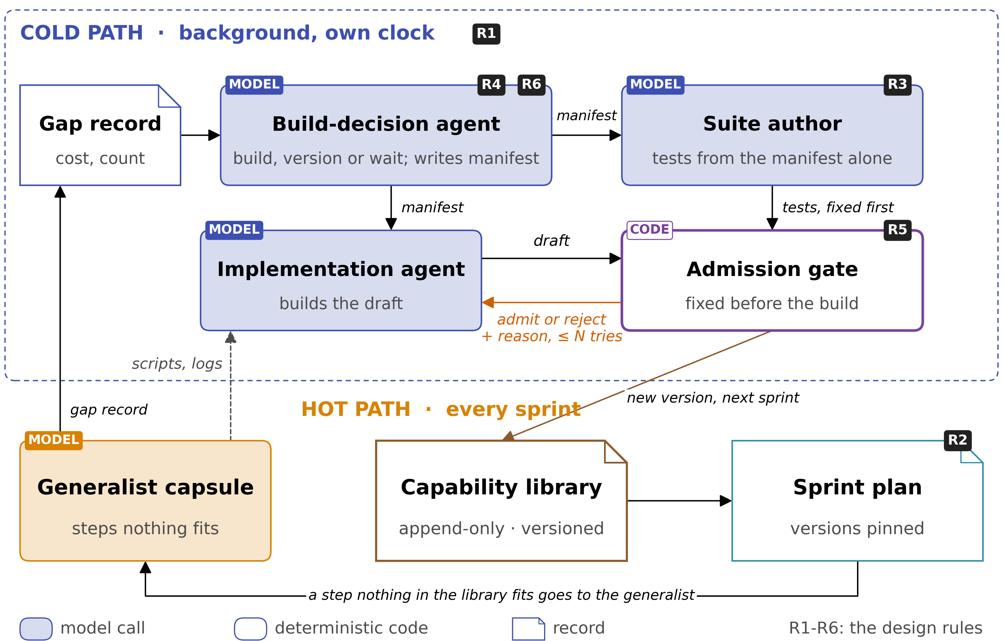
4 DESIGN (PROPOSED)
The design: 1 library, a generalist and a cold path
Capsule report §4, Fig. 8; Table 4
18
Notes:
TIME 1:40
SAY: Here's my recommendation for Capability Capsule. When planning can't find a suitable capsule for a step, it uses the generalist capsule instead. On that first run we don't build anything, but we store a gap record, so we know what this kind of step costs on the generalist and how many we needed. When the same gap keeps coming back across sprints, a separate build-decision agent looks at those costs and counts and decides whether to build a new capsule, version an existing one, or wait. If it builds, it writes the manifest, and a suite author writes the tests from that manifest alone, so the gate is fixed before any implementation starts. Then the implementation agent takes over. It can start from the generalist's scripts and logs, practise and debug its draft, never sees the tests, and gets a limited number of tries at the gate, hearing only admit or reject with a reason. A capsule that passes becomes a new version, available from the next sprint. The black badges are the 6 rules: R1 on the cold path, R4 and R6 on the build-decision agent, R3 on the suite author, R5 on the gate, and R2 on the sprint plan.
IF ASKED:
- Why cap the tries: unlimited retries let the builder learn the tests
- Why tests never use generalist outputs: they would pass anything that repeats its mistakes
- Out of tries or time, the gap goes back to the build-decision agent

Slide 21
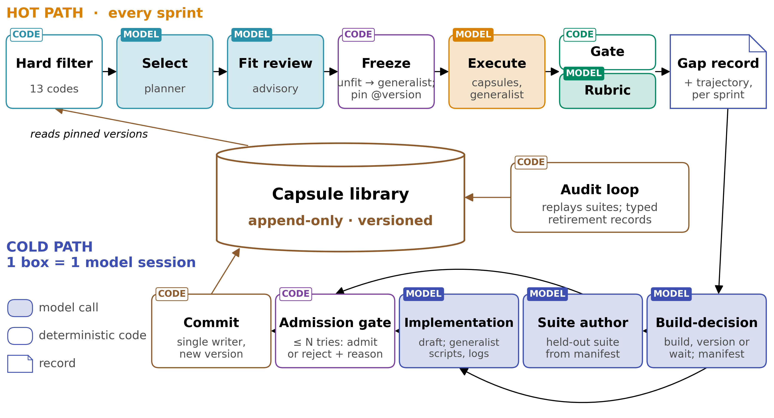
4 DESIGN (PROPOSED) · 3 LOOPS
3 loops run around 1 library, on separate clocks
The library is the only object all 3 loops touch: every read resolves a version some freeze pinned, the cold path is the only writer, and the audit loop appends
Capsule report App. G.2, Fig. G1
18a
Notes:
INSERT: optional slide; delete or hide it and the talk flows unchanged
TIME 0:40
SAY: Three loops run around 1 library. The hot path plans and runs a sprint and leaves a gap record for every node nothing fit. The cold path reads those records, writes the manifest and the held-out suite, and puts a draft to the gate. The audit loop re-runs every admitted capsule's suite on a schedule. The library is the only object all 3 touch, every read resolves a pinned version, and the cold path is the only writer, so no lock is needed.
IF ASKED:
- The hot path must work even if the cold path never admits a capsule, so the cold path is a background task that nothing waits on and can run on a separate server
- Halting a sprint until a pending build finishes would sometimes pay off, and it couples the clocks, so it is out of scope until the hot path runs reliably (Capsule report App. G.2)

Slide 22
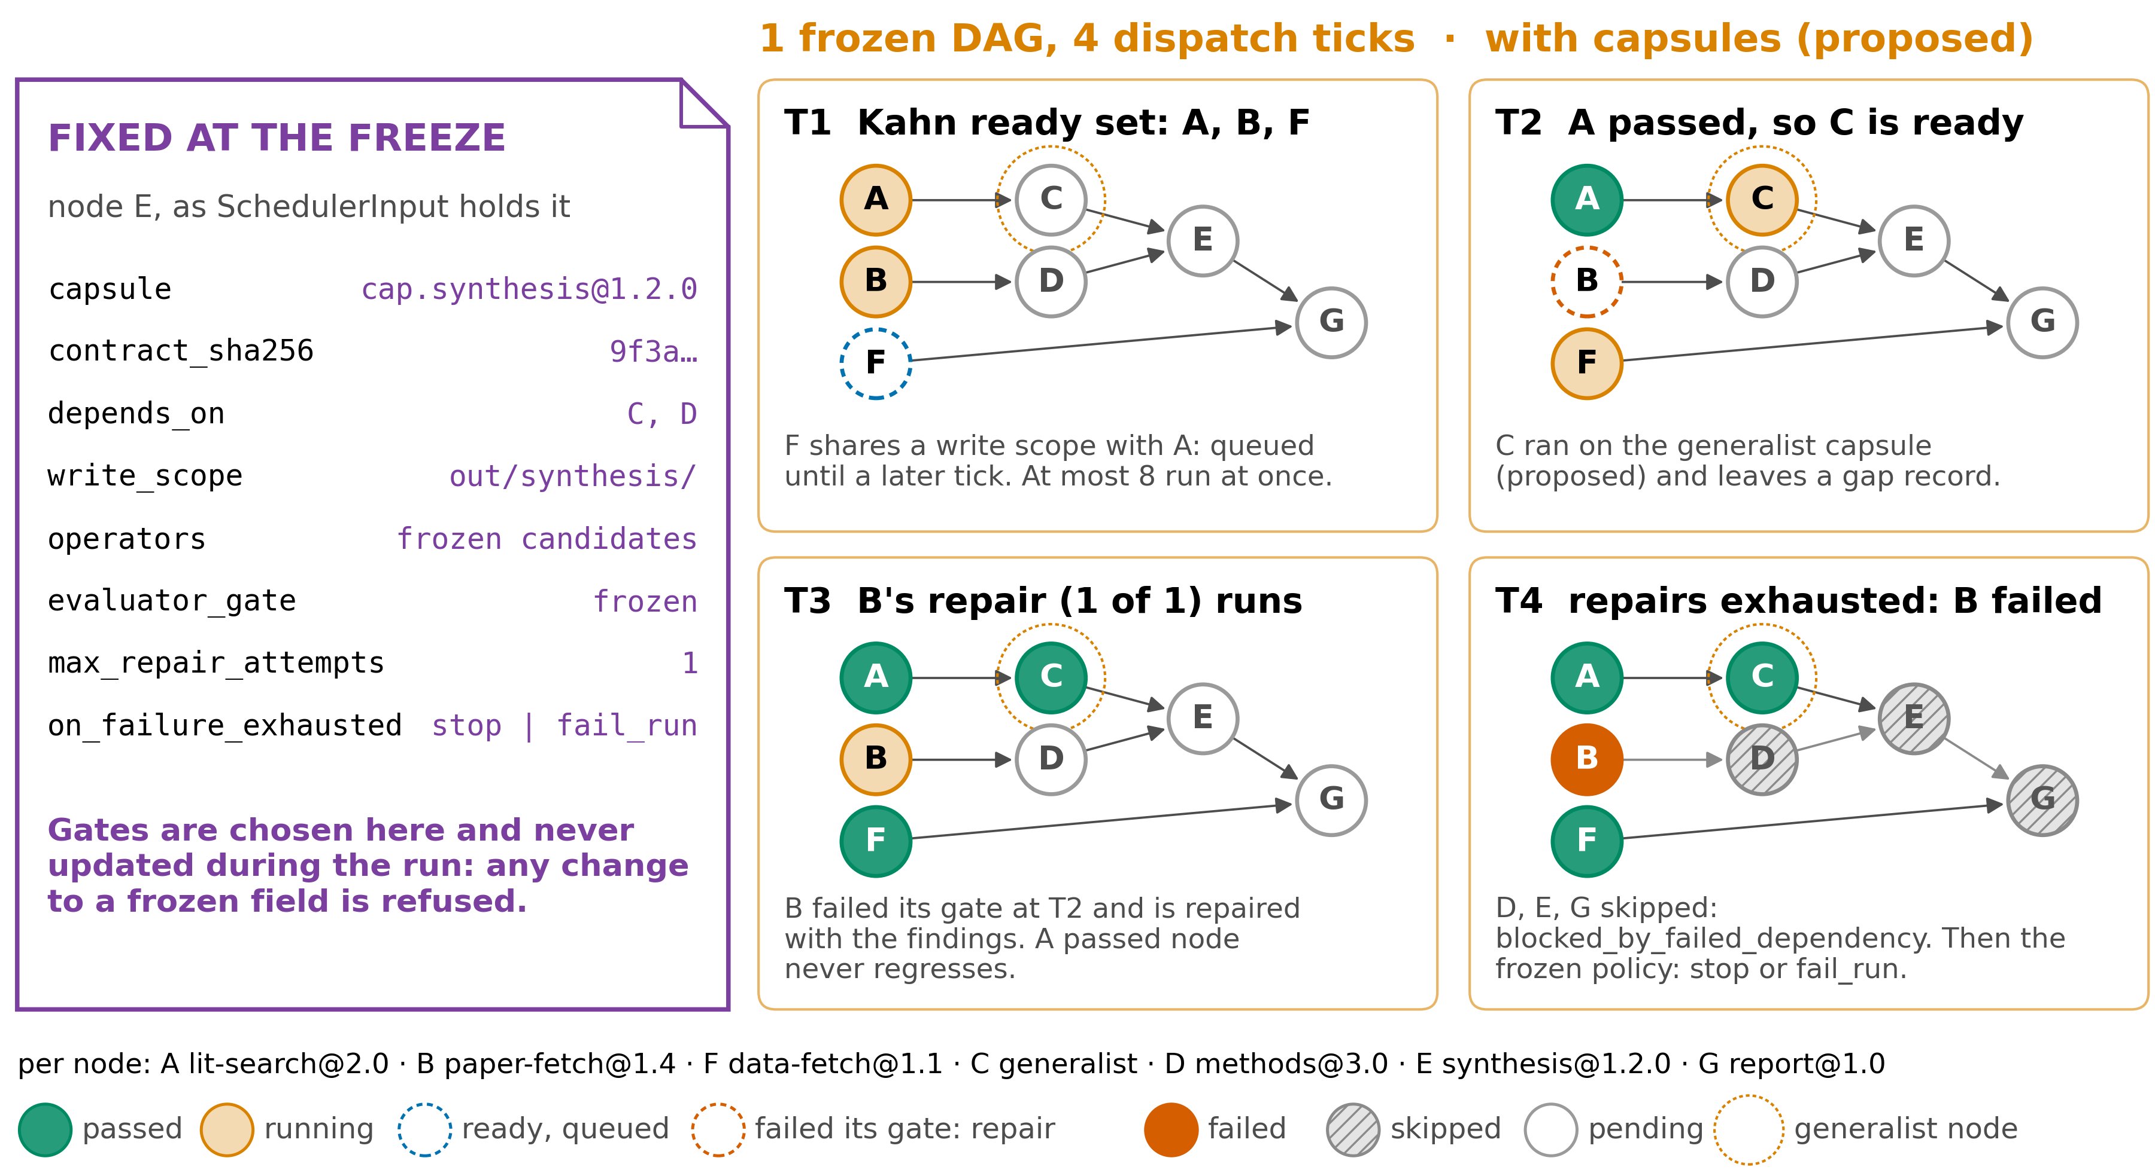
4 DESIGN (PROPOSED) · GENERALIST
The generalist finishes steps nothing else fits
Generalist: bound at planning to steps nothing fits · capped per plan · judged by that step's frozen gates · lowest trust · leaves a gap record, never writes to the library
Capsule report §4.1, Fig. 9, App. F
19
Notes:
TIME 0:45
SAY: This is the frozen task graph from the workflow talk, with a capsule on each step. The card on the left is what the freeze fixes for a step, including the exact capsule version. Step C runs on the generalist because nothing in the library fit. The generalist is judged by the same frozen gates as every other step, gets the lowest trust, leaves a gap record instead of writing to the library, and is capped per plan, so it cannot route around the typed contracts. Everything else, the queueing, the repair and the skipped steps, runs as the workflow talk described.
IF ASKED:
- Why not build and use a capsule in the same sprint: it would change what the freeze already sealed
- 2 switches in the frozen contract: generalist_fallback off/on, capability_authoring off/propose/build
- The cap on generalist steps per plan comes from the gap census of step 2, not from a value set today

Slide 23
4 DESIGN (PROPOSED) · GENERALIST
2 flags and a per-plan cap keep the generalist a fallback
generalist_fallback, off or on: whether a node may be bound to the generalist at all. Off means a node nothing fits fails the plan at the freeze, as it does today
capability_authoring, off, propose or build: whether generalist nodes leave gap records, and whether the cold path may build from them
Cost: the generalist is the most expensive way to complete a node short of building a capsule, and far cheaper than building one inside the sprint
Cap: the planner caps generalist nodes per plan, so the generalist does not become a way around the typed contracts of the other capsules
THUS both flags sit in the frozen run contract, so a sprint cannot change them partway through
Capsule report App. G.3; §4.1, App. F
19a
Notes:
INSERT: optional slide; delete or hide it and the talk flows unchanged
TIME 0:40
SAY: Two flags in the frozen run contract control the generalist, so a sprint cannot change them partway through. The first decides whether a node may be bound to the generalist, and with it off, such a node fails the plan at the freeze. The second decides whether generalist nodes leave gap records and whether the cold path may build from them. It is the most expensive way to complete a node short of building a capsule, and far cheaper than building one inside the sprint. The planner caps it per plan.
IF ASKED:
- Authoring never slows the sprint that found the gap, because the cold path runs off the critical path, so the authoring flag controls compute spent on building, not the duration of a run
- The value of the cap comes from the gap census of step 2, not from a value set today
- Generalist weights stay fixed: it only sees the cases no capsule fits, and training on those would narrow its ability to recover (Capsule report App. G.3, G.5)

Slide 24
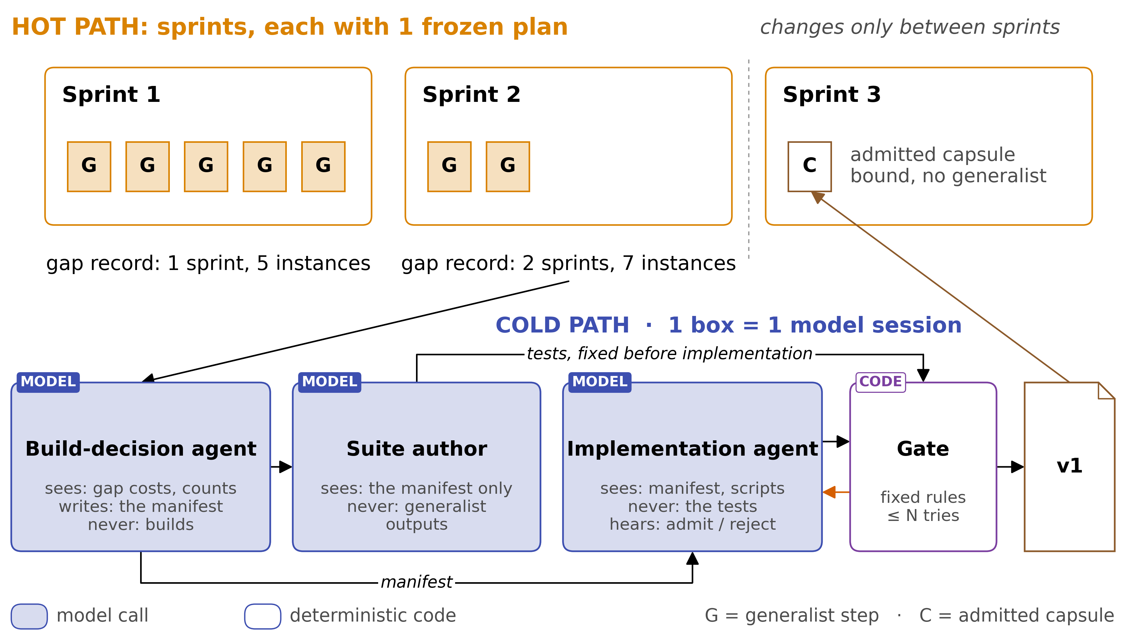
4 DESIGN (PROPOSED) · BUILD
Count repeats per sprint, and keep sessions apart
THUS 5 parallel steps count as 1 sighting, and declared write scopes keep them apart
Capsule report §4.2, Fig. 10, Table 5
20
Notes:
TIME 1:10
SAY: Top half: counting repeats. Sprint 1 has 5 generalist steps for the same gap, which is usually 1 need spread over 5 inputs, so that's 1 sighting, and 1 request on its own can never trigger a build. Those 5 steps run side by side safely because each one declares the paths it writes, and the scheduler won't put 2 overlapping writers in the same tick. Sprint 2 sees it again, so it's 2 sprints; in this example that's enough, and the cold path builds. Sprint 3 uses the new capsule. Bottom half: 3 model sessions, each seeing only what its job needs. The decider sees costs and counts and never builds, from AllocBench. The suite author works from the manifest alone, before any code exists. The implementation agent never sees the tests, and the gate is code. So 1 admission costs 3 model sessions, an effect check, and a suite re-run for as long as the capsule lives.
IF ASKED:
- A gap is identified by the types it consumes and produces, its effects and its task type
- How many sprints count as enough is an open question; it needs data from real gap records

Slide 25
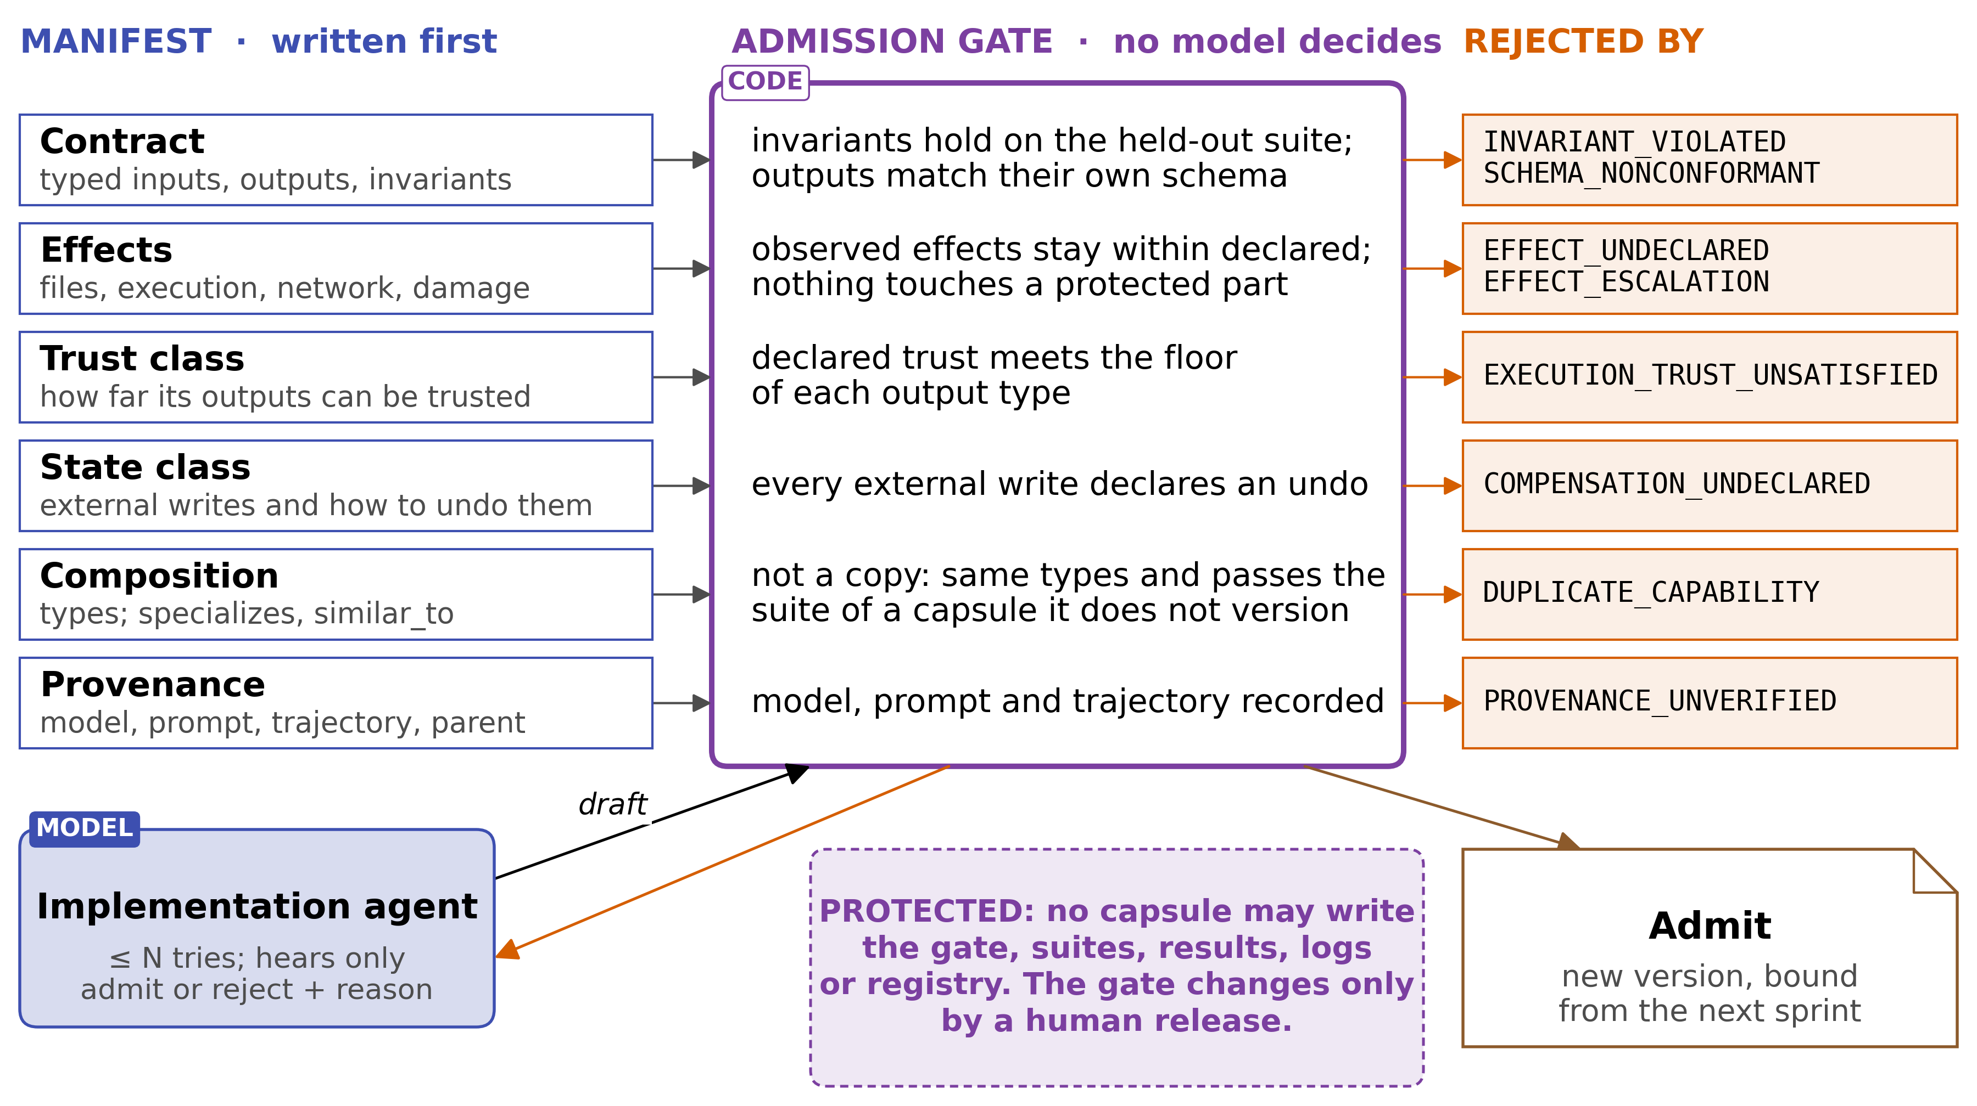
4 DESIGN (PROPOSED) · ADMISSION
Admission: each manifest field has a check
THUS tests check promises, not research answers; declared vs real effects is the new check
Capsule report §4.3, Fig. 11, App. C; other fields (identity, lifecycle, applicability) in App. C
21
Notes:
TIME 1:05
SAY: The manifest is written first, because the tests need something to check against. Research steps often have no right answer, so the tests check what the capsule promises rather than a research result. Read it row by row: each field is a promise, the gate checks it with fixed rules, and a broken promise has its own rejection code. The most important is effects: what the capsule actually touched in the sandbox log must stay inside what it declared, and none of the systems in these papers checks that. The duplicate check compares a candidate with every registered capsule except the one it versions. The protected box is due to DGM lesson, enforced by write access, not by hiding.
IF ASKED:
- The suite author and the implementer can share 1 misreading of a new capability, since a research step has no ground-truth oracle. The control group and the effects check catch it
- Where quality needs judgment, a different model from the builder grades it, and its verdict enters only as a recorded result
- How many capsules can be tested without a right answer is unmeasured; held-out tests for a sample, step 6 of the order of work, will show it
- What may change, most reversible first: the library by versions, then context and prompts
- No paper compares contract-first with contract-last; this is a design choice

Slide 26
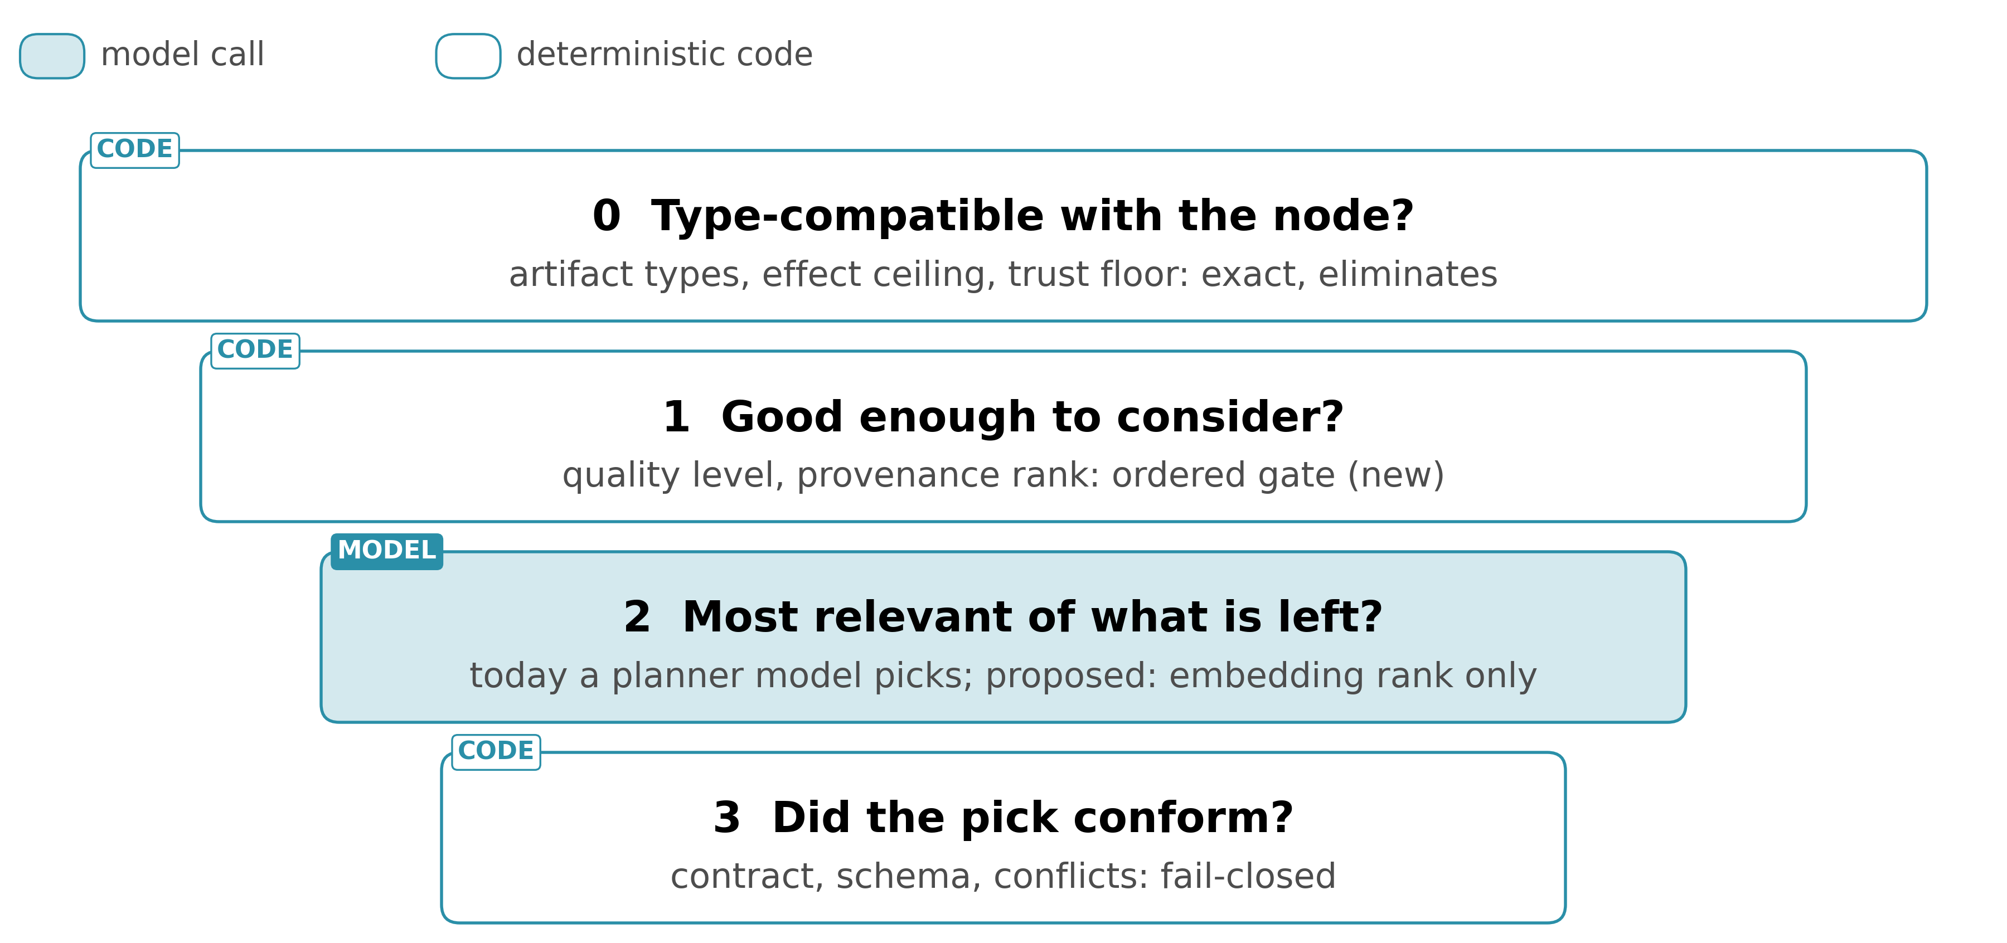
4 DESIGN (PROPOSED) · SELECTION
Picking a capsule: exact checks first, similarity last
THUS similarity only ranks what passed the exact checks; it never lets a capsule in
Capsule report §4.4, Fig. 12
22
Notes:
TIME 0:50
SAY: Picking a capsule happens every sprint. First anything whose types, effects or trust don't match is removed. Then anything below a quality floor. Only then is what's left ranked, and the pick is checked again, so a similarity threshold can never let a wrong capsule in, which was Alita-G's problem. Today a planner model makes that ranking choice; I propose embeddings because this runs for every step. Alita-G shows similarity is sensitive, so the 2 should be compared on the same candidates.
IF ASKED:
- Today stage 0 and most of stage 3 already exist; stage 1 is new

Slide 27
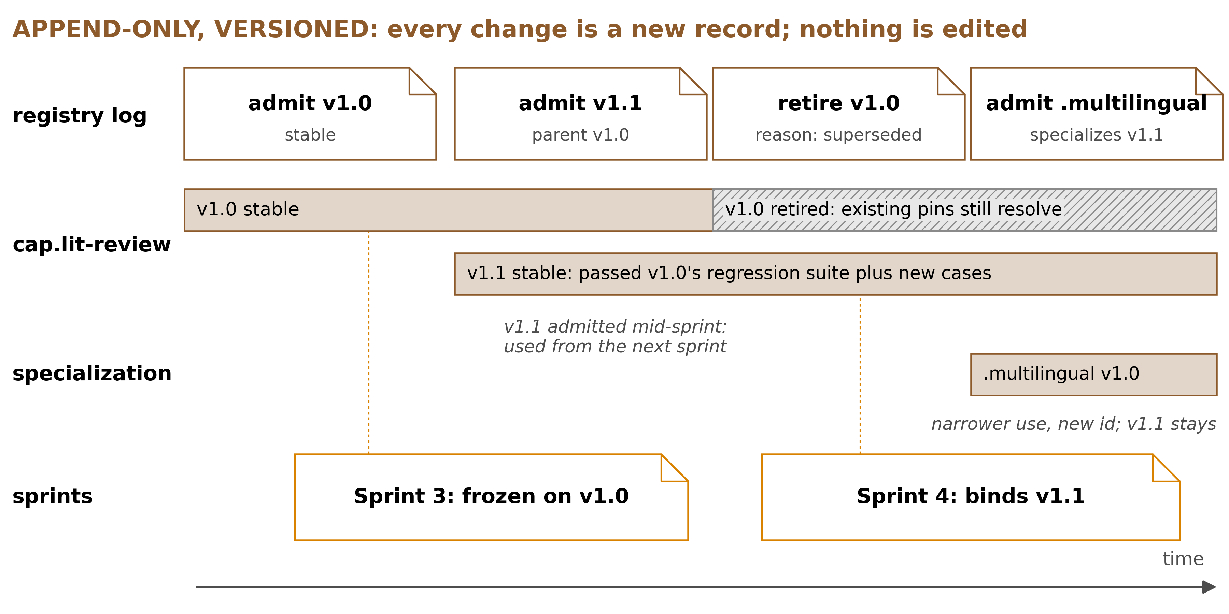
4 DESIGN (PROPOSED) · LIFECYCLE
Append-only and versioned: improve, never edit
New version: same types and effects, passes all old tests
Specialization: a narrower use under a new id
Contract changed: a new capsule, full admission
Retired: unload the plugin, keep the record
Model weights never change: the library does
Capsule report §4.5, Fig. 13; App. G
23
Notes:
TIME 1:25
SAY: Nothing in the library is ever edited or deleted: admitting, versioning, specializing and retiring all add a record. Sprint 3 froze on version 1.0. Version 1.1 arrives while it runs, and sprint 3 keeps using 1.0; sprint 4 uses 1.1. A new version must pass everything the old one passed, so it can't do worse on anything tested before. A narrower use becomes a specialization with its own id, and a changed contract is a new capsule. Retiring is 2 things at once. The runtime unloads the plugin and unwinds everything it registered, and the record stays in the log so a sprint that pinned it can still resolve it. Running sprints carry on unless the reason is security, and results from a capsule that later fails its tests are flagged. Results can't be un-published, which is why admission has to be strict. Every admitted capsule's suite is re-run on a schedule, so one that breaks later is caught and retired. DeepSeek Harness already publishes durable data as version-named successors, so append-only versioning is the platform's own rule. The model weights never change. What changes is the library, then the context and prompts.
IF ASKED:
- What counts as a breaking change is an open question
- No paper measures updating a capability; the monotone rule is my proposal
- Versions come first in the order of work, because today any change aborts the freeze
- Each retirement reason and its policy: report App. G

Slide 28
4 DESIGN (PROPOSED) · LIFECYCLE
Each retirement reason selects its own policy
Reason | Trust signal | Running plans | Evidence already produced | Future planning
superseded, deprecated or redundant | none | continue | valid | not selectable; superseded and redundant name the successor
performance_regression | weak | continue | valid | demoted before retirement
conformance_failed | yes | continue, flagged | suspect downstream | blocked
effect_violation | security | abort and quarantine | suspect and audited | blocked with its lineage
provenance_revoked | security | abort | whole lineage suspect | blocked with its lineage
THUS only an effect violation and a revoked provenance abort work that is already running
Capsule report §4.5; App. G.6 Table G1
23a
Notes:
INSERT: optional slide; delete or hide it and the talk flows unchanged
TIME 0:40
SAY: Retirement is an appended record with a typed reason, and the reason picks the policy. Superseded, deprecated or redundant: running plans continue, the evidence stays valid, and the capsule is no longer selectable. A performance regression demotes it first. A conformance failure lets plans continue but flags them, and downstream evidence becomes suspect. An effect violation aborts and quarantines. A revoked provenance aborts, and the whole lineage is suspect and blocked.
IF ASKED:
- 4 triggers retire or demote: a failed replay of the admission suite in the audit loop, a declared invariant broken on a real output, effects outside the declared ones, and a decline in task success, which only demotes
- The record is a tombstone that keeps the retired version resolvable for a plan that pinned it; the disposal is the runtime running the inverses of everything the version registered
- A capsule composed on top of a retired one is deactivated before the disposal reaches it (arXiv 2608.25512, Thm. 70)

Slide 29
5 EVALUATION
How to know it works, and what would prove it wrong
Track | Measures
A task performance | task scores with no library, a library without the gate, and with it, since the evidence splits on whether a library helps
B capability conformance | declared vs real effects, test results, duplicates
C generality | whether the generalist stays general on tasks kept aside
• Wrong if real effects almost never differ from declared ones: the new check is worth little
• Wrong if gaps rarely come back: the cold path rarely fires, and the generalist with its gap record is most of the system
• Wrong if checking costs more than reuse saves: not building is the usual answer
• Control: the 79 hand-written capsules take the same tests; a failure is the build, not the test
THUS prediction, gate off vs on: similar task scores, far fewer broken capsules
Capsule report §5, Table 6; §5.1, Table 7
24
Notes:
TIME 0:55
SAY: 3 ways to measure it: task scores, whether capabilities actually do what they claim, and whether the generalist stays general. Task scores are measured 3 ways, no library, a library without the gate, and with it, because the evidence splits on whether a self-built library raises task scores at all. My prediction is that turning the gate on barely moves task scores but leaves far fewer broken capsules, because Beyond Task Completion found broken tools in sessions that still passed their tasks. And 3 results would prove me wrong: real effects that almost never differ from what was declared, gaps that rarely come back, or checking that costs more than reuse saves. Each of those has a test, and that's the next slide.
IF ASKED:
- Does a self-built library raise task scores at all: evidence both ways. Alita-G gained 8 points on its own questions; in Beyond Task Completion, 35.8% of tasks passed with self-made tools against 33.7% with the seed tools only, not a significant difference, on 1 model
- Control: the 79 hand-written capsules take the same held-out tests, so a failure belongs to the generated capsule, not the tests; this holds only once the hand-written ones pass
- Costs Alita-G doesn't pay: the generalist on every step nothing fits, a suite author and an effect check for every admission, and re-running every capsule's tests on a schedule

Slide 30
5 EVALUATION
5 signals after 10 sprints: continue, narrow or stop
Signal | Continue | Narrow to selection only | Stop building
gap recurrence across sprints | a few gap identities carry most instances |  | most identities appear in 1 sprint only; the generalist and its gap record stay
admission rate and the mix of rejection reasons | some rejections, undeclared effects among them | almost every draft admitted first time, so the gate does little work | almost nothing admitted while the control passes the same suites
reuse count against build cost | saved exceeds build cost for most admitted capsules |  | build cost exceeds saved for most; a higher threshold is tried once first
held-out conformance with the gate off, against the control | built capsules fail suites the control passes | built capsules pass as often as the control, so the gate is redundant | the control fails too: fix the suites before reading anything else
generality retention | generalist success on held-out tasks within run-to-run noise |  | generalist success falls as the library grows
THUS an empty cell means the signal does not point to that decision
Capsule report §5.2, Table 8; rejection reasons in App. C Table C2
24a
Notes:
INSERT: optional slide; delete or hide it and the talk flows unchanged
TIME 0:40
SAY: After 10 sprints, 5 signals are read together. If a few gap identities carry most instances, keep going; if most appear in 1 sprint only, stop building and keep the generalist and its gap record. If almost every draft is admitted first time, the gate does little work and the system narrows to selection. If reuse saves less than the build costs, raise the threshold once, then stop. If built capsules pass as often as the control, the gate is redundant, and if the control fails too, the suites come first.
IF ASKED:
- k is proposed as 10, 5 times the starting threshold of 2 sprints, so a capsule built at the threshold has several sprints in which to be bound
- A failing signal is checked against the control first, since a control that fails the same test says the test is at fault
- The control is the 79 hand-written capsules taking the same held-out suites

Slide 31
5 EVALUATION · VERIFY FIRST
What to verify first, and what each result would change
Assumption | Test | Fails if
gaps come back across sprints | census of gap records over the first 10 sprints (step 2) | most gaps appear in 1 sprint only: stop building, keep the generalist and gap record
real effects differ from declared ones | declared vs real effects on a sample of today's capsules (step 7) | they almost never differ: narrow to selection only
reuse repays admission | generalist cost saved per admitted capsule vs its build cost (step 8) | most capsules never repay: raise the threshold once, then stop building
hand-written capsules pass held-out tests | write tests for a sample of the 79 (step 6) | they fail, or most cases need a rubric: fix the tests before reading anything else
practice feedback from a separate verifier | build the same gaps both ways (step 8) | admission rate the same within noise: keep the cheaper source
embeddings rank what passed the exact checks | rank the same survivors both ways (after step 4) | embedding picks fail their gates more often: keep the planner's pick
starts: 2 sprints from AllocBench, 5 gate tries from CoEvoSkills | census replayed at thresholds; admissions by try number | built capsules are rarely bound again; admissions cluster at the last tries
THUS first result that could change the plan: a gap census where gaps never come back
Capsule report §5.1, Table 7; §5.2, Table 8; step numbers from §6
25
Notes:
TIME 0:55
SAY: Before trusting any of this, these are the things to check, in the order the work produces them. First the gap census, after about 10 sprints: it counts how often the same gap comes back. If most appear once, there's nothing to build, and we keep just the generalist and the gap record. Then 2 checks on the capsules we already have: whether real effects ever differ from declared ones, and whether hand-written capsules pass held-out tests at all. A hand-written capsule that fails means the tests are wrong, not the capsules. The rest needs the cold path: whether reuse repays admission, and the 2 head-to-heads. The starting values, 2 sprints and 5 tries, come from AllocBench and CoEvoSkills, and the same data revises them.
IF ASKED:
- Why 10 sprints: 5 times the 2-sprint threshold, so a capsule built at the threshold has several sprints in which to be bound; a proposed value, not a measured one
- Why 2 and 5: the 2nd sighting is the first confirmed repeat AllocBench's best policy waits for; 5 is the bound CoEvoSkills puts on its pass/fail oracle
- The 5 signals read together after 10 sprints, and what each pattern means: report Table 8

Slide 32
6 NEXT
Order of work, and what needs deciding
1 capsule_id@version
2 generalist capsule + gap record
3 protected-path deny list
4 unify the 2 type vocabularies
5 has the gate ever rejected a real capsule?
6 held-out tests for a sample
7 declared vs real effects on that sample
8 the cold path
9 load, swap and retire on DSH
For | Question
decide first | Sprints before a build: start at 2. Gate tries per build: start at 5. Both revised from the data
decide first | What is a breaking change? A changed type or an added effect. How many generalist steps per plan?
test first | Practice feedback from a separate verifier session, as in CoEvoSkills, or the builder's own tests?
test first | Rank candidates by embeddings, or keep the planner model's pick? Does the library raise task scores at all?
supervisor | Interactive, autonomous, or both? Research contribution or internal tool? Which tasks are held out?
supervisor | Unattended runs cannot use approval-gated steps. Credentials, network (deny by default), multi-tenant runs, who approves?
Capsule report §6; Table 7
26
Notes:
TIME 1:20
SAY: Versions first, then the generalist and gap records, then protected paths. Steps 2, 6 and 7 read the first 3 rows of the previous slide on the capsules we already have, and the cold path comes last. Steps 1 to 7 change code that already exists and read data the system already writes, so the cold path at step 8 is the only new subsystem. Step 9 stands apart: 2 throwaway capsules on DeepSeek Harness, loaded, swapped and retired in one session, and run side by side with overlapping writes. It needs no cold path, so it can go at any point, and it is the only step that needs a running DeepSeek Harness. On the right, 3 kinds of question. The first 2 rows need a decision before building, and each has a starting value I'd propose. The next 2 are experiments where the evidence points both ways. The last 2 are for you. If runs are unattended on a server, anything that needs a human approval simply can't run, so network access is deny by default with declared exceptions.
IF ASKED:
- Deny network by default with declared exceptions is the only policy that matches effect declarations
- A resubmitted request is not a new sighting, by the rule that 1 request cannot trigger a build
- The recommendation in 5 sentences, with its cost and the first result that would change it: report §6, closing paragraph

Slide 33
4 DESIGN (PROPOSED) · CAPSULES ON DSH
A capsule is a manifest around a DeepSeek Harness plugin
Capsule concern | DeepSeek Harness mechanism | What the capsule layer adds
implementation | a plugin that provides a tool | the manifest: contract, effects, trust class, verification
versions | plugin package versions; durable data published as version-named successors | exact versions pinned in each sprint's frozen plan
admission | adding the plugin to the profile the next sprint boots | the admission gate that decides whether it is added
retirement | unloading the plugin, whose registrations unwind | lifecycle state, and flagging evidence the capsule produced
a new version while sprints run | a plugin loads and the version it improves unloads, with no restart | the rule that a new version binds only from the next sprint
Capsule report App. D, Table D1 · DSH 0.1.5-rc.2 at c291e7961a: docs/architecture.md:13, :121
26a
Notes:
INSERT: optional slide; delete or hide it and the talk flows unchanged
TIME 0:40
SAY: A capsule is a manifest around a DeepSeek Harness plugin. The implementation is a plugin that provides a tool, and the manifest adds the contract, effects, trust class and verification. Versions are plugin package versions, and each sprint's frozen plan pins the exact ones. Admission is adding the plugin to the profile the next sprint boots, and a gate decides whether it goes in. Retirement is unloading it, so its registrations unwind. A new version loads while sprints run and binds from the next sprint.
IF ASKED:
- The headless and SDK profiles apply their plugin configuration once at startup, which matches admitting capsules only between sprints (Capsule report App. D)
- DSH is a developer preview at version 0.1.5-rc.2; it has not been run for this report

Slide 34
4 DESIGN (PROPOSED) · CAPSULES ON DSH
The checks around a capsule are what the platform lacks
Capsule concern | DeepSeek Harness mechanism | What the capsule layer adds
declared vs observed effects | sandbox access logs; the tool catalog's required services and session events | the comparison, made before admission
protected components | sandbox policy denying writes | the list of what is protected
the generalist capsule | a sandboxed agent run recorded in the append-only session log | the node contract, the gates, the trust class and the gap record
external writes | not undone by unloading | a declared way to undo each one, or rejection
2 capsules active at once | the effects of distinct plugins interleave without disturbing one another | declared write scopes and effects, which the scheduler reads before it selects a node
Capsule report App. D, Table D1 · A Programming Paradigm for Spatiotemporal Composability (arXiv 2608.25512) §1.1, §3
26b
Notes:
INSERT: optional slide; delete or hide it and the talk flows unchanged
TIME 0:40
SAY: The checks around a capsule are what DeepSeek Harness does not provide. Sandbox logs record what a capsule touched, and the comparison with what it declared happens before admission. Sandbox policy denies writes, and the capsule layer lists what is protected. The generalist runs sandboxed in the session log, with a contract, gates and a gap record from its manifest. Unloading never undoes an external write, so each one declares how it is undone.
IF ASKED:
- Reversal in Cordis is observational: it reverts registrations, bindings and allocations, not files written or network calls made (arXiv 2608.25512 §3.3)
- A capsule with a large blast radius gets full verification however rarely it is reused (Capsule report App. G.4)

